Slide 1
CHAPTER 6
STRUCTURED QUERY LANGUAGE(SQL)

Slide 2
SQL is a comprehensive database language: It has statements for data definition, query, and update
Hence, it is both a DDL and a DML.
In addition, it has facilities for defining views on the database, for specifying security and authorization, for defining integrity constraints, and for specifying transaction controls.
SQL uses the terms table, row, and column for the formal relational model terms relation, tuple, and attribute, respectively
The main SQL command for data definition is the CREATE statement, which can be used to create schemas, tables (relations), and domains (as well as other constructs such as views, assertions, and triggers)

Slide 3
Schema Concepts in SQL
All tables (relations) were considered part of the same schema
The concept of an SQL schema was incorporated in order to group together tables and other constructs that belong to the same database application
An SQL schema is identified by a schema name, and includes an authorization identifier to indicate the user or account who owns the schema, as well as descriptors for each element in the schema.
Schema elements include tables, constraints, views, domains, and other constructs (such as authorization grants since all users are not allowed to create schema, tables…etc ) that describe the schema sin.
A schema is created via the CREATE SCHEMA statement, which can include all the schema elements' definitions
For example, the following statement creates a schema called COMPANY, owned by the user with authorization identifier JSMITH:
CREATE SCHEMA COMPANY AUTHORIZATION JSMITH;

Slide 4
The CREATE TABLE Command in SQL
The CREATE TABLE command is used to specify a new relation by giving it a name and specifying its attributes and initial constraints.
The attributes are specified first, and each attribute is given a name, a data type to specify its domain of values, and any attribute constraints, such as NOT NULL.
The key, entity integrity, and referential integrity constraints can be specified within the CREATE TABLE statement after the attributes are declared.
We can explicitly attach the schema name to the relation name, separated by a period.
For example, by writing
CREATE TABLE COMPANY.EMPLOYEE ...
rather than
CREATE TABLE EMPLOYEE . . .

Slide 5
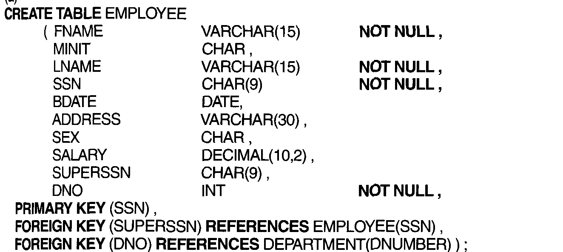

Slide 6
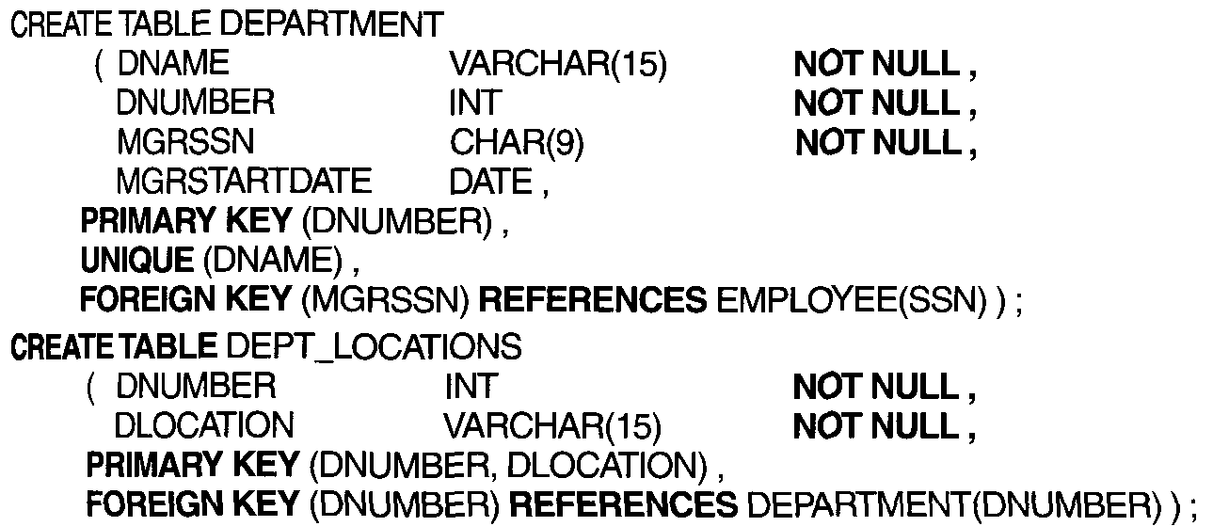

Slide 7
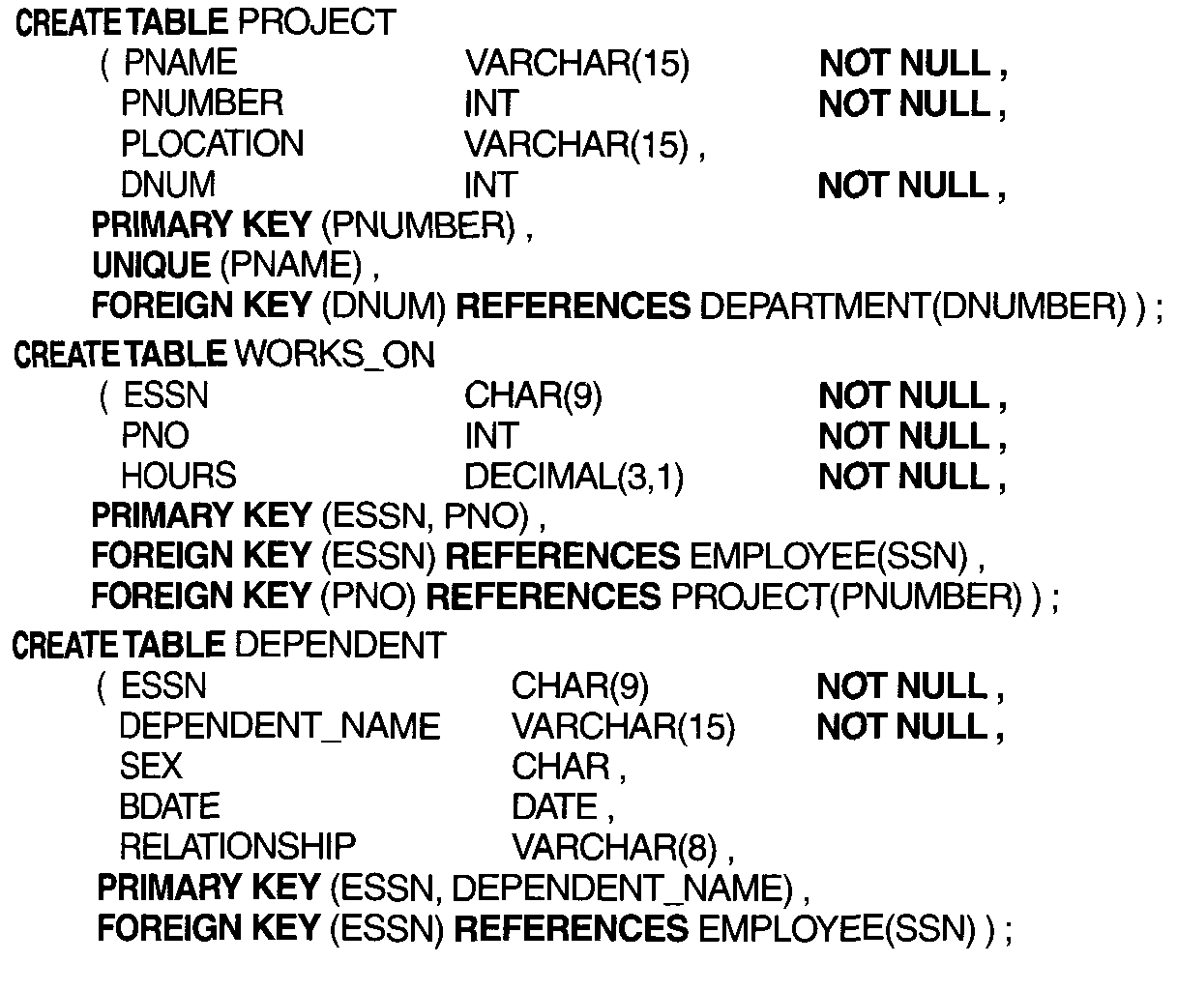

Slide 8
Attribute Data Types and Domains in SQL
The basic data types available for attributes include numeric, character string, bit string, boolean, date, and time.
Numeric data types : include integer numbers of various sizes (INTEGER or INT, and SMALLINT) and floating-point (real) numbers of various precision.
Character-string data types: are either fixed length--CHAR(n) or CHARACTER(n), where n is the number of characters-or varying length-VARCHAR(n)
Bit-string data types: are either of fixed length n-BIT(n)-or varying length-BIT VARYING(n), where n is the maximum number of bits
A boolean data type: has the traditional values of TRUE or FALSE. In SQL, because of the presence of NULL values, a three-valued logic is used, so a third possible value for a boolean data type is UNKNOWN
Date and time:The DATE data type has ten positions, and its components are YEAR, MONTH, and DAY in the form YYYY-MM-DD

Slide 9
a domain can be declared to specify a data type, and the domain name used with the attribute specification.
This makes it easier to change the data type for a domain that is used by numerous attributes in a schema, and improves schema readability.
For example, we can create a domain SSN_TYPE by the following statement:
CREATE DOMAIN SSN_TYPE AS CHAR(9);
We can use SSN_TYPE in place of CHAR(9) for the attributes SSN and SUPERSSN of EMPLOYEE, MGRSSN of DEPARTMENT, ESSN of WORKS_ON, and ESSN of DEPENDENT declared before.

Slide 10
SPECIFYING BASIC CONSTRAINTS IN SQl
Basic constraints include key and referential integrity constraints, as well as restrictions on attribute domains and NULLs, and constraints on individual tuples within a relation.
Specifying Attribute Constraints and Attribute Defaults
a constraint NOT NULL may be specified if NULL is not permitted for a particular attribute.
This is always implicitly specified for the attributes that are part of the primary key of each relation, but it can be specified for any other attributes whose values are required not to be NULL
It is also possible to define a default value for an attribute by appending the clause DEFAULT <value> to an attribute definition
The default value is included in any new tuple if an explicit value is not provided for that attribute

Slide 11
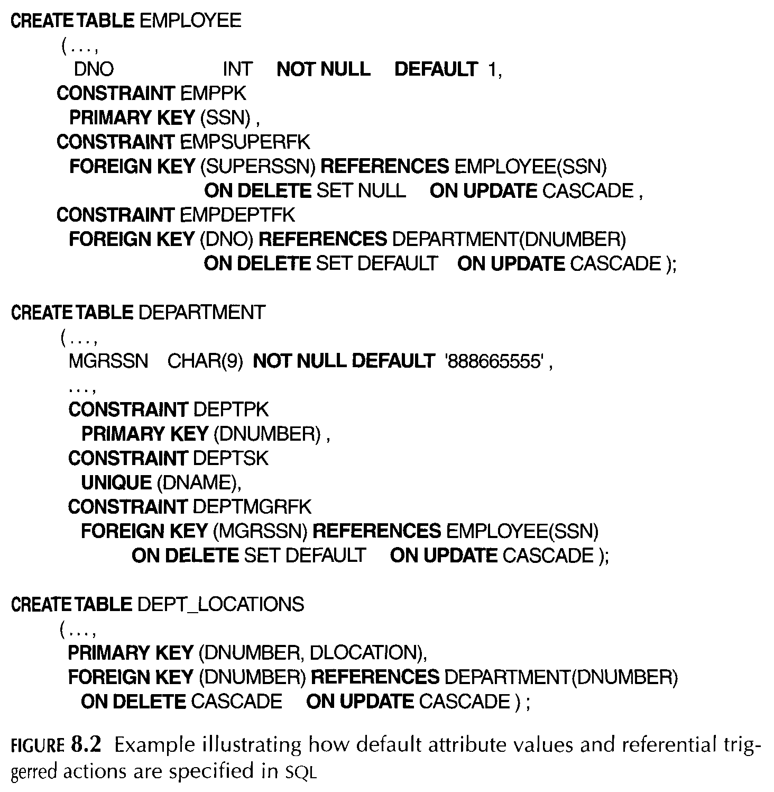

Slide 12
Specifying Key and Referential Integrity Constraints
If a primary key has a single attribute, the clause can follow the attribute directly.
For example: the primary key of DEPARTMENT can be specified as follows (instead of the way it is specified before) as
DNUMBER INT PRIMARY KEY;
Referential integrity is specified via the FOREIGN KEY clause
a referential integrity constraint can be violated when tuples are inserted or deleted, or when a foreign key or primary key attribute value is modified
schema designer can specify an alternative action to be taken if a referential integrity constraint is violated, by attaching a referential triggered action like ON DELETE or ON UPDATE SET NULL, CASCADE, and SET DEFAULT.

Slide 13
For example: SET NULL ON DELETE and CASCADE ON UPDATE for the foreign key SUPERSSN of EMPLOYEE.
This means that if the tuple for a supervising employee is deleted, the value of SUPERSSN is automatically set to NULL for all employee tuples that were referencing the deleted employee tuple.
On the other hand, if the SSN value for a supervising employee is updated (say, because it was entered incorrectly), the new value is cascaded to SUPERSSN for all employee tuples referencing the updated employee tuple.

Slide 14
Schema change statements
used to alter a schema by adding or dropping tables, attributes, constraints, and other schema element
The DROP Command
The DROP command can be used to drop named schema elements, such as tables, domains, or constraints
For example, if a whole schema is not needed any more, the DROP SCHEMA command can be used.
There are two drop behavior options: CASCADE and RESTRICT.
For example, to remove the COMPANY database schema and all its tables, domains, and other elements, the CASCADE option is used as follows:
DROP SCHEMA COMPANY CASCADE;

Slide 15
The alter command
tables or other named schema elements can be changed by using the ALTER command
For base tables, the possible alter table actions include adding or dropping a column (attribute), changing a column definition, and adding or dropping table constraints.
For example to add an attribute for keeping track of jobs of employees to the EMPLOYEE relations in the COMPANY schema, we can use the command
ALTER TABLE EMPLOYEE ADD JOB VARCHAR(12);
To drop a column, we must choose either CASCADE or RESTRICT for drop behavior.
If CASCADE is chosen, all constraints and views that reference the column are dropped automatically from the schema, along with the column.

Slide 16
The alter command
For example, the following command removes the attribute ADDRESS from the EMPLOYEE base table:
ALTER TABLE EMPLOYEE DROP ADDRESS CASCADE;
It is also possible to alter a column definition by dropping an existing default clause or by defining a new default clause.
The following examples illustrate this clause:
ALTER TABLE DEPARTMENT ALTER MGRSSN DROP DEFAULT;
ALTER TABLE DEPARTMENT ALTER MGRSSN SET DEFAULT "333445555";

Slide 17
Basic Queries in SQL

Slide 18
1. THE SElECT Statement
The SElECT-FROM-WHERE Structure syntax
SELECT<attribute list>
FROM<table list>
WHERE<condition>;
Where
<attribute list> is a list of attribute names whose values are to be retrieved by the query.
<table list> is a list of the relation names required to process the query.
<condition> is a conditional (Boolean) expression that identifies the tuples to be retrieved by the query.

Slide 19
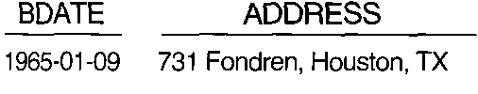
Example 1:
Retrieve the birthdate and address of the employee) whose name is 'John B. Smith'.
SELECT BDATE, ADDRESS
FROM EMPLOYEE
WHERE FNAME='John' AND MINIT='B' AND LNAME='Smith';
The query selects the EMPLOYEE tuples that satisfy the condition of the WHERE clause, then projects the result on the BDATE and ADDRESS attributes listed in the SELECT.
is similar to the following relational algebra expression
∏BDATE,ADDRESS(σFNAME=' John' AND MINIT=' B' AND LNAME=' Smith' (EMPLOYEE))

Slide 20
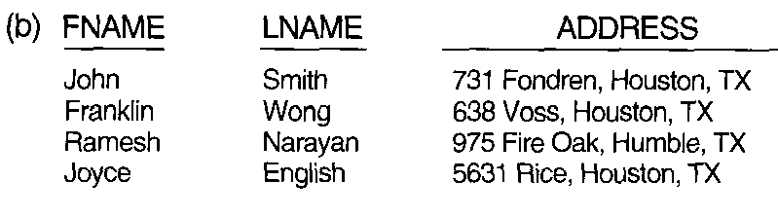
Example 2:
Retrieve the name and address of all employees who work for the 'Research' department.
SELECT FNAME,LNAME,ADDRESS
FROM EMPLOYEE,DEPARTMENT
WHERE DNAME='Research' AND DNUMBER=DNO;
Example:3
For every project located in 'Stafford', list the project number, the controlling department number, and the department manager's last name, address, and birthdates.

Slide 21

SELECT PNUMBER,DNUM,LNAME,ADDRESS,BDATE
FROM PROJECT,DEPARTMENT,EMPLOYEE
WHERE DNUM=DNUMBER AND MGRSSN=SSN AND
PLOCATION=“Stafford”;
The join condition DNUM = DNUMBER relates a project to its controlling department, whereas the join condition MGRSSN = SSN relates the controlling department to the employee who manages that department

Slide 22

Ambiguous Attribute Names, Aliasing, and Tuple Variables
In SQL the same name can be used for two (or more) attributes as long as the attributes are in different relations.
If this is the case, and a query refers to two or more attributes with the same name, we must qualify the attribute name with the relation name to prevent ambiguity.
This is done by prefixing the relation name to the attribute name and separating the two by a period.
Ex : if the DNO and LNAME attributes of the EMPLOYEE relation were called DNUMBER and NAME, and the DNAME attribute of DEPARTMENT was also called NAME. Then to prevent ambiguity, the query rewritten as :

Slide 23
Ambiguity also arises in the case of queries that refer to the same relation twice, as in the following example
Example: For each employee, retrieve the employee's first and last name and the first and last name of his or her immediate supervisor.
SELECT E.FNAME, E.LNAME, S.FNAME, S.LNAME
FROM EMPLOYEE AS E, EMPLOYEE AS S
WHERE E.SUPERSSN=S.SSN;
In this case, we are allowed to declare alternative relation names E and S, called aliases or tuple variables, for the EMPLOYEE relation.
An alias can follow the keyword AS, as shown in above, or it can directly follow the relation name-for example, by writing EMPLOYEE E, EMPLOYEE S in the FROM clause
IN this example we can think of E and S as two different copies of the EMPLOYEE relation; the first, E, represents employees in the role of supervisees; the second, S, represents employees in the role of supervisors.

Slide 24
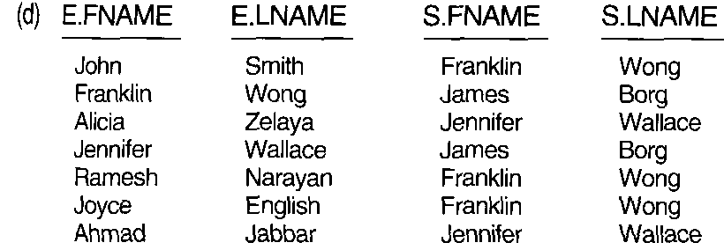
It is also possible to rename the relation attributes within the query in SQL by giving them aliases. For example, if we write EMPLOYEE AS E(FN, MI, LN, SSN, SD, ADDR, SEX, SAL, SSSN, DNO)

Slide 25

Unspecified WHERE Clause and Use of the Asterisk
A missing WHERE clause indicates no condition on tuple selection; hence, all tuples of the relation specified in the FROM clause qualify and are selected for the query result
EX1: SELECT SSN
FROM EMPLOYEE;
If more than one relation is specified in the FROM clause and there is no WHERE clause, then the CROSS PRODUCT-all possible tuple combinations-of these relations is selected.
Ex2: SELECT SSN ,DNAME
FROM EMPLOYEE, DEPARTMENT;
To retrieve all the attribute values of the selected tuples, we do not have to list the attribute names explicitly in SQL; we just specify an asterisk (*), which stands for all the attribute
Ex SELECT *
FROM EMPLOYEE
WHERE DNO=5;

Slide 26
Tables as Sets in SQl
DISTINCT
SQL usually treats a table not as a set but rather as a multiset; duplicate tuples can appear more than once in a table.
An SQL table with a key is restricted to being a set, since the key value must be distinct in each tuple
If we do want to eliminate duplicate tuples from the result of an SQL query, we use the keyword DISTINCT in the SELECT clause, meaning that only distinct tuples should remain in the result
A query with SELECT DISTINCT eliminates duplicates, whereas a query with SELECT ALL does not.
example, Query (a) retrieves the salary of every employee; if several employees have the same salary, that salary value will appear as many times in the result of the query:
If we are interested only in distinct salary values, we want each value to appear only once, regardless of how many employees earn that salary. By using the keyword DISTINCT as in Query (b), we accomplish this,

Slide 27
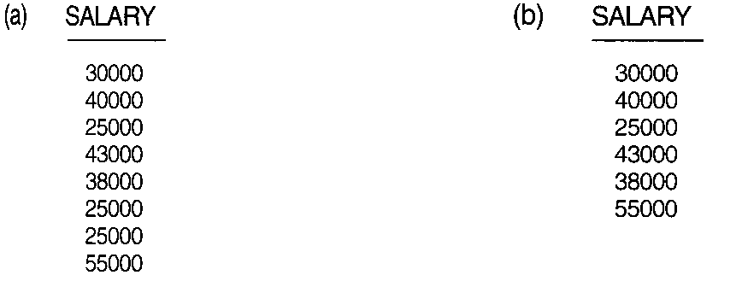
Query a):
SELECT SALARY
FROM EMPLOYEE
Query b):
SELECT DISTINCT SALARY
FROM EMPLOYEE

Slide 28
SET UNION,INTERSECTION, AND DIFFERENCE IN SQL
SQL has directly incorporated some of the set operations of relational algebra.
There are set union (UNION), set difference (EXCEPT), and set intersection (INTERSECT) operations.
The relations resulting from these set operations are sets of tuples; that is, duplicate tuples are eliminated from the result.
Example: Make a list of all project numbers for projects that involve an employee whose last name is 'Smith', either as a worker or as a manager of the department that controls the project
(SELECT DISTINCT PNUMBER
FROM PROJECT, DEPARTMENT, EMPLOYEE
WHERE DNUM=DNUMBER AND MGRSSN=SSN AND LNAME='Smith')
UNION
(SELECT DISTINCT PNUMBER
FROM PROJECT, WORKS_ON, EMPLOYEE
WHERE PNUMBER=PNO AND ESSN=SSN AND LNAME='Smith');

Slide 29
The first SELECT query retrieves the projects that involve a 'Smith' as manager of the department that controls the project, and the second retrieves the projects that involve a 'Smith' as a worker on the project.
Notice that if several employees have the last name 'Smith', the project names involving any of them will be retrieved.
Applying the UNION operation to the two SELECT queries gives the desired result.

Slide 30
Substring Pattern Matching and Arithmetic Operators
This section describes several pattern matching in SQL
LIKE : allows comparison conditions on only parts of a character string, using the comparison operator or string pattern matching
Partial strings are specified using two reserved characters:
% replaces an arbitrary number of zero or more characters, and the underscore (_) replaces a single character.
Example: To Retrieve all employees whose address is in Houston, Texas.
SELECT FNAME, LNAME
FROM EMPLOYEE
WHERE ADDRESS LIKE '%Houston,TX%';
To select all names of employee that start with “T”
SELECT FNAME
FROM EMPLOYEE
WHERE FNAME LIKE “T%”;

Slide 31

To retrieve all employees who were born during the 1950s, we can use the next query.
Here, '5' must be the third character of the string (according to our format for date), so we use the value ‘_ _ 5_ _ _ _ _ _ _ ', with each underscore serving as a placeholder for an arbitrary character.
Another feature allows the use of arithmetic in queries

Slide 32
Another feature allows the use of arithmetic in queries
For example, suppose that we want to see the effect of giving all employees who work on the 'ProductX' project a 10 percent raise
SELECT FNAME, LNAME, 1.1*SALARY AS INCREASED_SAL
FROM EMPLOYEE, WORKS_ON, PROJECT
WHERE SSN=ESSN AND PNO=PNUMBER AND PNAME='ProductX';
BETWEEN: is Another comparison operator that can be used for retrieving values in a given range
EX: Retrieve all employees in department 5 whose salary is between $30,000 and $40,000.
SELECT *
FROM EMPLOYEE
WHERE (SALARY BETWEEN 30000 AND 40000) AND DNO =5;
The condition (SALARY BETWEEN 30000 AND 40000) in above is equivalent to the condition ((SALARY >= 30000) AND (SALARY <= 40000».

Slide 33
Ordering of Query Results
SQL allows the user to order the tuples in the result of a query by the values of one or more attributes, using the ORDER BY clause
Example: Retrieve a list of employees and the projects they are working on, ordered by department and, within each department, ordered alphabetically by last name, first name.
SELECT DNAME, LNAME, FNAME, PNAME
FROM DEPARTMENT, EMPLOYEE, WORKS_ON, PROJECT
WHERE DNUMBER=DNO AND SSN=ESSN AND PNO=PNUMBER
ORDER BY DNAME, LNAME, FNAME;
The default order is in ascending order of values
Retrieve the names of all employees who do not have supervisors.
Comparisons Involving NULL
Ex: Retrieve the names of all employees who do not have supervisors
SELECT FNAME, LNAME
FROM EMPLOYEE
WHERE SUPERSSN IS NULL;

Slide 34
Nested Queries,
Some queries require that existing values in the database be fetched and then used in a comparison condition.
Such queries can be conveniently formulated by using nested queries, which are complete select-from-where blocks within the WHERE clause of another query.
Ex: SELECT DISTINCT PNUMBER
FROM PROJECT
WHERE PNUMBER IN ( SELECT PNUMBER
FROM PROJECT, DEPARTMENT, EMPLOYEE
WHERE DNUM=DNUMBER AND MGRSSN=SSN AND
LNAME='Smith')
OR
PNUMBERIN (SELECT PNO FROM WORKS_ON, EMPLOYEE
WHERE ESSN=SSN AND LNAME='Smith');
The first nested query selects the project numbers of projects that have a 'Smith‘ involved as manager while the second selects the project numbers of projects that have a 'Smith' involved as worker. we use the OR logical connective to retrieve a PROJECT tuple if the PNUMBER value of that tuple is in the result of either nested query.

Slide 35
Example2: Retrieve the name of each employee who has a dependent with the same first name and same sex as the employee.
SELECT E.FNAME, E.LNAME
FROM EMPLOYEE AS E
WHERE E.SSN IN (SELECT ESSN
FROM DEPENDENT
WHERE E.FNAME=DEPENDENT_NAME AND
E.SEX=SEX);

Slide 36
The EXISTS and UNIQUE Functions in SQL
The EXISTS function in SQL is used to check whether the result of a correlated nested query is empty (contains no tuples) or not.
ex1:Retrieve the names of employees who have no dependents
SELECT FNAME, LNAME
FROM EMPLOYEE
WHERE NOT EXISTS (SELECT * FROM DEPENDENT
WHERE SSN=ESSN);
Ex2:List the names of managers who have at least one dependent.
SELECT FNAME, LNAME
FROM EMPLOYEE
WHERE EXISTS (SELECT *FROM DEPENDENT
WHERE SSN=ESSN)
AND
EXISTS (SELECT *
FROM DEPARTMENT
WHERE SSN=MGRSSN);

Slide 37
Aggregate Functions in SQL
A number of built-in functions exist: COUNT, SUM, MAX, MIN, and AVG
EX: Find the sum of the salaries of all employees, the maximum salary, the minimum salary,and the average salary.
SELECT SUM (SALARY), MAX (SALARY), MIN (SALARY),AVG (SALARY)
FROM EMPLOYEE;
EX2: Find the sum of the salaries of all employees of the 'Research' department, as well as the maximum salary, the minimum salary, and the average salary in this department.
SELECT SUM (SALARY), MAX (SALARY), MIN (SALARY),AVG (SALARY)
FROM (EMPLOYEE JOIN DEPARTMENT ON DNO=DNUMBER)
WHERE DNAME='Research';

Slide 38
EX3: Retrieve the total number of employees in the company (Q21)
SELECT COUNT (*)
FROM EMPLOYEE;
EX4: Retrieve the number of employees in the 'Research' department (
SELECT COUNT (*)
FROM EMPLOYEE,DEPARTMENT
WHERE DNO=DNUMBER AND DNAME='Research';
Herethe asterisk (*) refers to the rows (tuples), so COUNT (*) returns the number of rows in the result of the query
We may also use the COUNT function to count values in a column rather than tuples, as in the next example.
Ex5: Count the number of distinct salary values in the database.
SELECT COUNT (DISTINCT SALARY)
FROM EMPLOYEE;

Slide 39
JOIN ED TABLES IN SQL
Helps users to specify a table resulting from a join operation in the FROM clause of a query.
For example, consider the following query, which retrieves the name and address of every employee who works for the 'Research' department.
It may be easier first to specify the join of the EMPLOYEE and DEPARTMENT relations, and then to select the desired tuples and attributes.
SELECT FNAME, LNAME, ADDRESS
FROM (EMPLOYEE JOIN DEPARTMENT ON DNO=DNUMBER)
WHERE DNAME='Research';
Reading assignment: left join
outer join
inner join

Slide 40
Grouping: The GROUP BY and HAVING Clauses
In many cases we want to apply the aggregate functions to subgroups of tuples in a relation, where the subgroups are based on some attribute values.
For example, we may want to find the average salary of employees in each department or the number of employees who work on each project.
The GROUP BY clause specifies the grouping attributes, which should also appear in the SELECT clause, so that the value resulting from applying each aggregate function to a group of tuples appears along with the value of the grouping attributes.

Slide 41
Ex: For each department, retrieve the department number, the number of employees in the department, and their average salary.
SELECT DNO , COUNT (*), AVG (SALARY)
FROM EMPLOYEE
GROUP BY DNO;
In this query the EMPLOYEE tuples are partitioned into groups-each group having the same value for the grouping attribute DNO. The COUNT and AVG functions are applied to each such group of tuples
the SELECT clause includes only the grouping attribute and the functions to be applied on each group of tuples.
The result is shown in figure 8.6(a)

Slide 42
Ex2: For each project, retrieve the project number, the project name, and the number of employees who work on that project.
SELECT PNUMBER, PNAME, COUNT (*)
FROM PROJECT, WORKS_ON
WHERE PNUMBER=PNO
GROUP BY PNUMBER, PNAME;
In this example, the grouping and functions are applied after the joining of the two relations(The result is shown in 8.6(b))
Sometimes we want to retrieve the values of these functions only for groups that satisfy certain conditions
For example, suppose that we want to modify ex2 so that only projects with more than two employees appear in the result.
SQL provides a HAVING clause, which can appear in conjunction with a GROUP BY clause, for this purpose

Slide 43
Example: For each project on which more than two employees work, retrieve the project number, the project name, and the number of employees who work on the project.
SELECT PNUMBER, PNAME, COUNT (*)
FROM PROJECT, WORKS_ON
WHERE PNUMBER=PNO
GROUP BY PNUMBER, PNAME
HAVING COUNT (*) > 2;

Slide 44
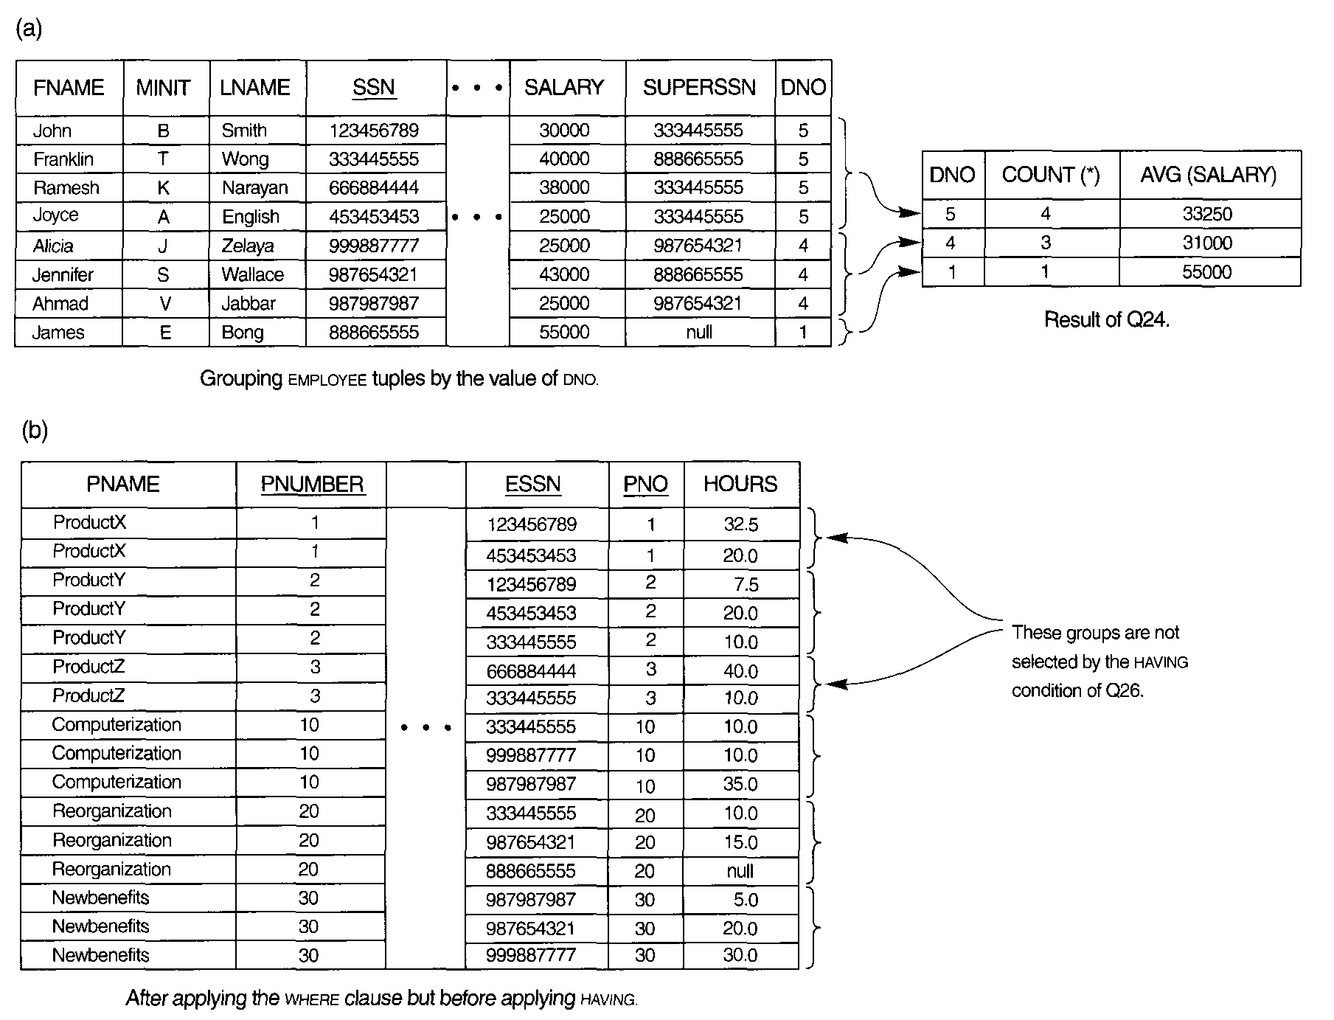

Slide 45
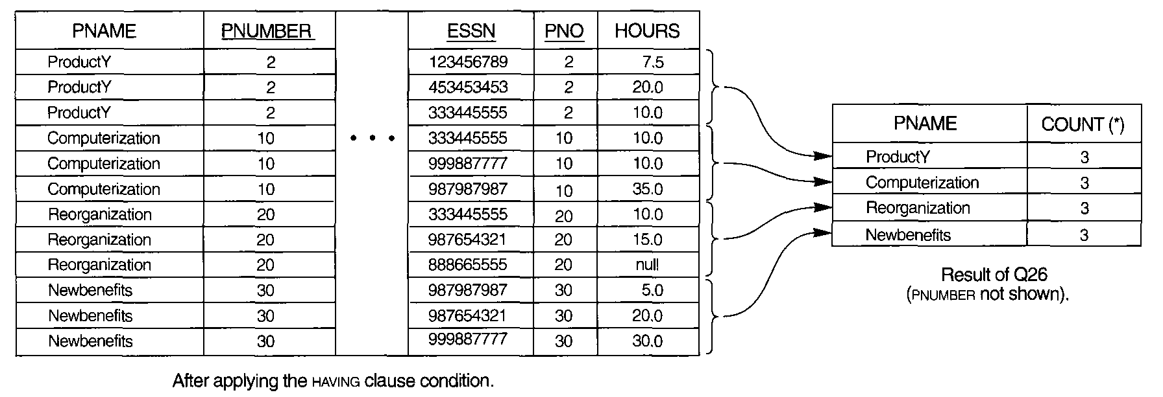

Slide 46
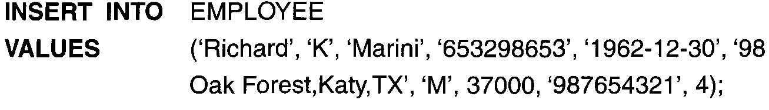
Insert, Delete, and Update Statements in SQL
In SQL, three commands can be used to modify the database: INSERT, DELETE, and UPDATE.
The INSERT Command
In its simplest form, INSERT is used to add a single tuple to a relation. We must specify the relation name and a list of values for the tuple.
The values should be listed in the same order in which the corresponding attributes were specified in the CREATE TABLE.
Example:

Slide 47

A second form of the INSERT statement allows the user to specify explicit attribute names that correspond to the values provided in the INSERT command.
This is useful if a relation has many attributes but only a few of those attributes are assigned values in the new tuple.
However, the values must include all attributes with NOT NULL specification and no default value

Slide 48
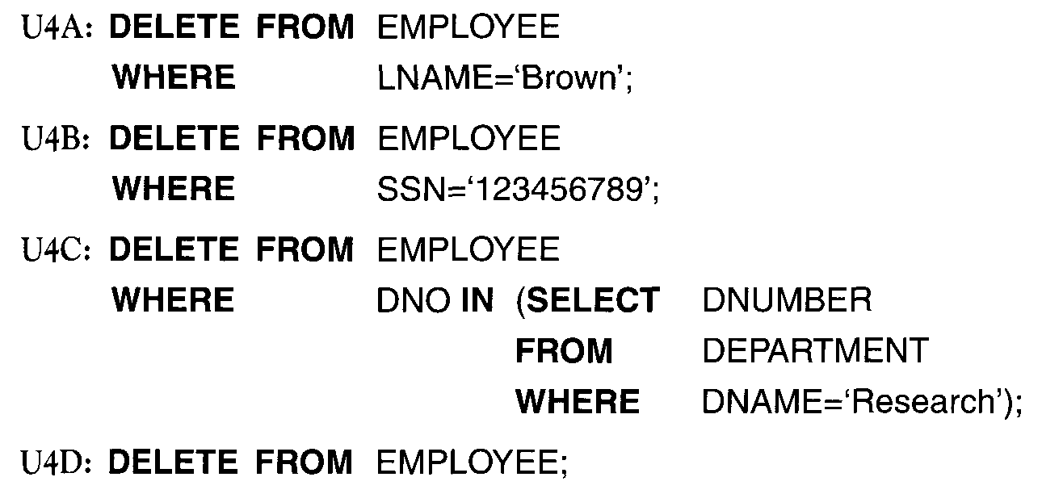
The Delete Command
The DELETE command removes tuples from a relation.
It includes a WHERE clause, similar to that used in an SQL query, to select the tuples to be deleted
A missing WHERE clause specifies that all tuples in the relation are to be deleted;

Slide 49
The UPDATE Command
The UPDATE command is used to modify attribute values of one or more selected tuples.
As in the DELETE command, a WHERE clause in the UPDATE command selects the tuples to be modified from a single relation
For example, to change the location and controlling department number of project number 10 to 'Bellaire' and 5, respectively, we use:
UPDATE PROJECT
SET PLOCATION = 'Bellaire', DNUM = 5
WHERE PNUMBER=10;
Several tuples can be modified with a single UPDATE command.
An example is to give all employees in the 'Research' department a 10 percent raise in salary, as shown
UPDATE EMPLOYEE
SET SALARY = SALARY *1.1
WHERE
DNO IN (SELECT DNUMBER
FROM DEPARTMENT
WHERE DNAME='Research');

